Slide 1
Learning Unix/Linux
Bioinformatics Orientation 2008
Eric Bishop

Slide 2
Introduction: What is Unix?
An operating system
Developed at AT&T Bell Labs in the 1960’s
Command Line Interpreter
GUIs (Window systems) are now available

Slide 3
Introduction: Unix vs. Linux
Unix was the predecessor of Linux
Linux is a variant of Unix
  So is Mac OS X, so much of this tutorial applies to Macs as well
Linux is open source
Most of the machines you’ll use in the Bioinformatics program are running the Linux OS

Slide 4
Introduction: Why Unix/Linux?
Linux is free
It’s fully customizable
It’s stable (i.e. it almost never crashes)
These characteristics make it an ideal OS for programmers and scientists

Slide 5
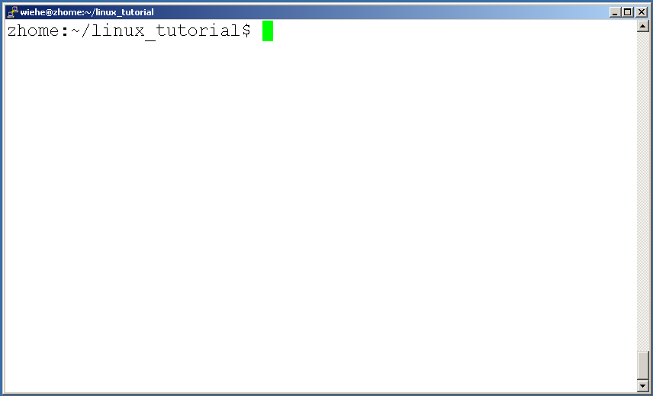
Connecting to a Unix/Linux system
Open up a terminal:

Slide 6
Connecting to a Unix/Linux system
Open up a terminal:
The “prompt”
The current directory (“path”)
The host

Slide 7
What exactly is a “shell”?
After logging in, Linux/Unix starts another program called the shell
The shell interprets commands the user types and manages their execution
    The shell communicates with the internal part of the operating system called the kernel
    The most popular shells are: tcsh, csh, korn, and bash
    The differences are most times subtle
    For this tutorial, we are using bash
Shell commands are CASE SENSITIVE!

Slide 8
Help!
Whenever you need help with a command type “man” and the command name

Slide 9
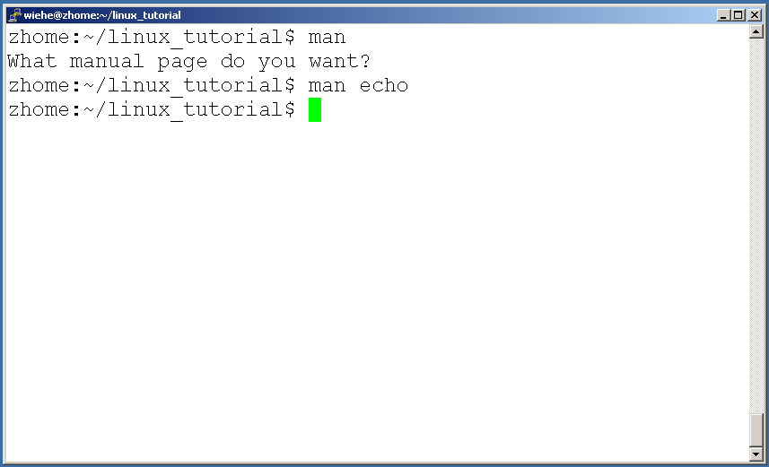
Help!

Slide 10
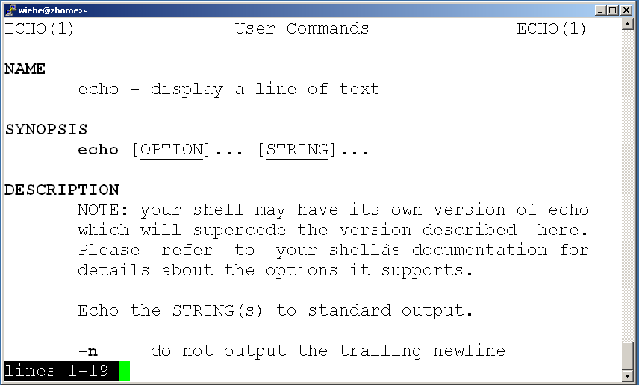
Help!

Slide 11
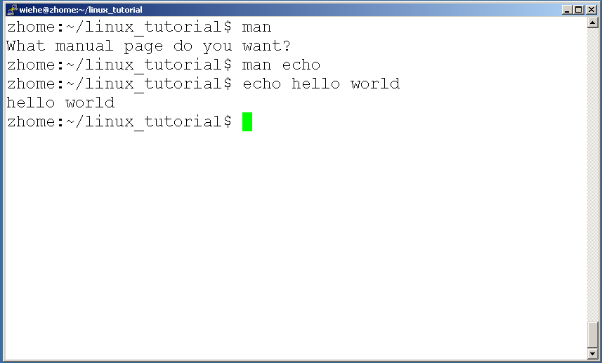
Help!

Slide 12
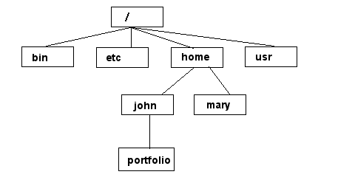
Unix/Linux File System
NOTE: Unix file names
are CASE SENSITIVE!
/home/mary/
/home/john/portfolio/
The Path

Slide 13
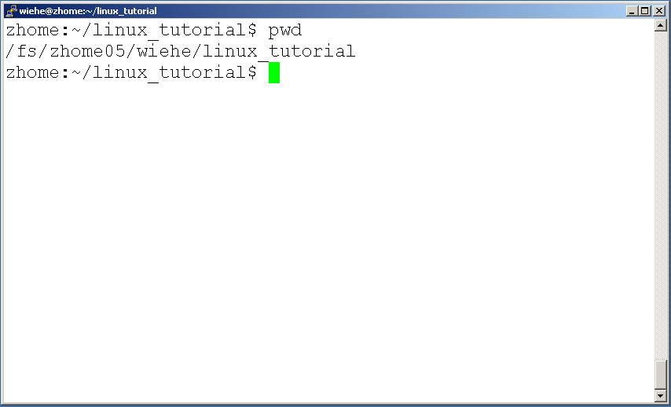
Command: pwd
To find your current path use “pwd”

Slide 14
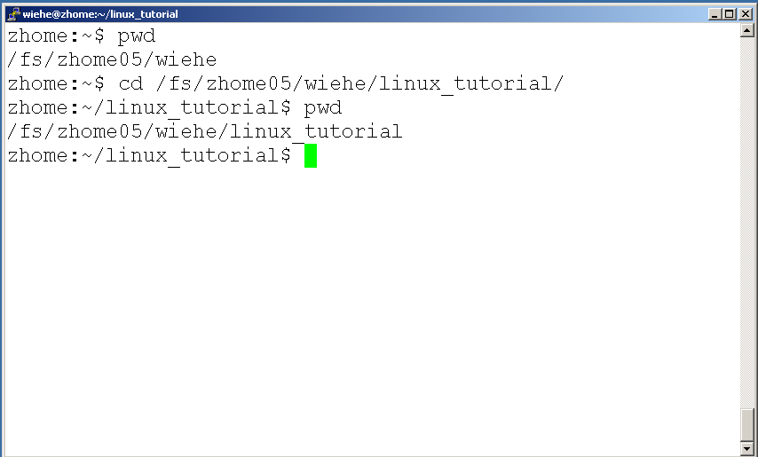
Command: cd
To change to a specific directory use “cd”

Slide 15
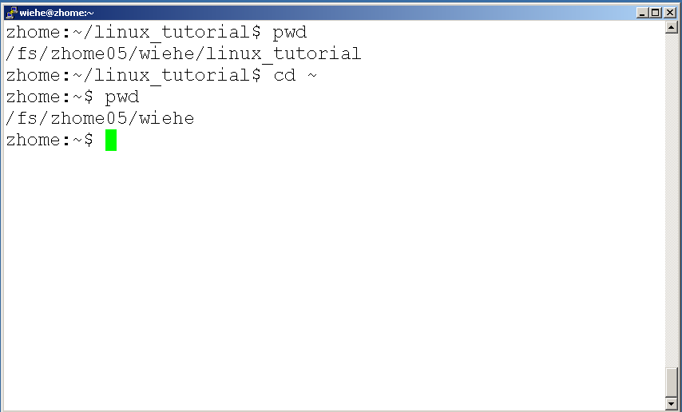
Command: cd
“~” is the location of your home directory

Slide 16
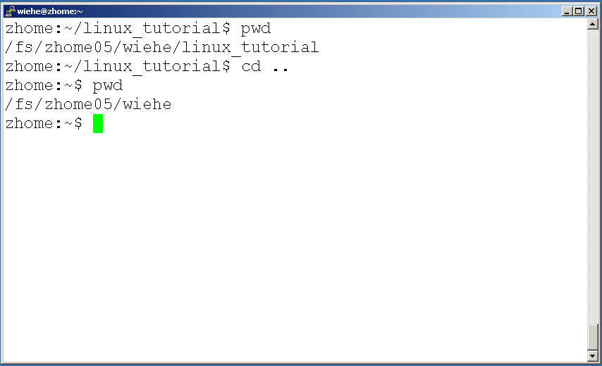
Command: cd
“..” is the location of the directory below current one

Slide 17
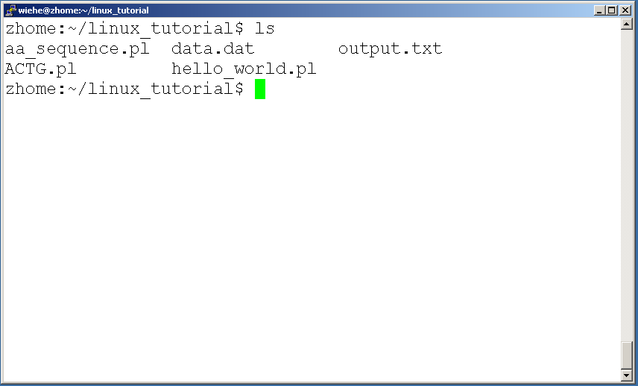
Command: ls
To list the files in the current directory use “ls”

Slide 18
Command: ls
ls has many options
  -l long list (displays lots of info)
  -t sort by modification time
  -S sort by size
  -h list file sizes in human readable format
  -r reverse the order
“man ls” for more options
Options can be combined: “ls -ltr”

Slide 19
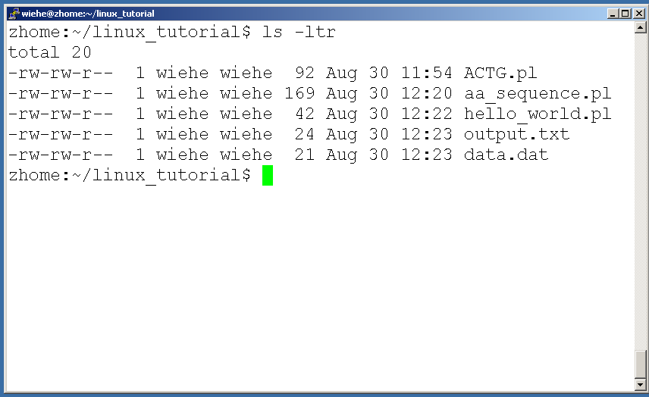
Command: ls -ltr
List files by time in reverse order with long listing

Slide 20
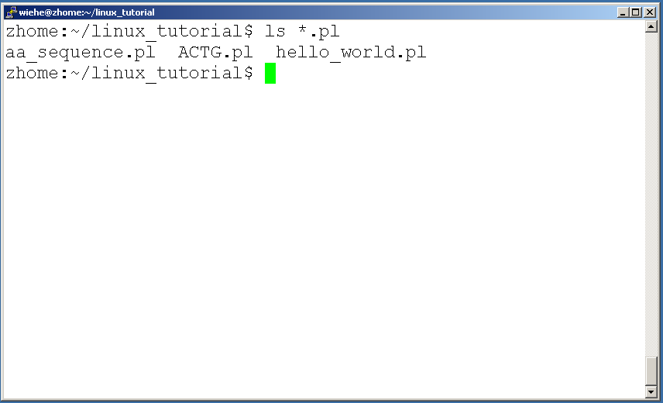
General Syntax: *
“*” can be used as a wildcard in unix/linux

Slide 21
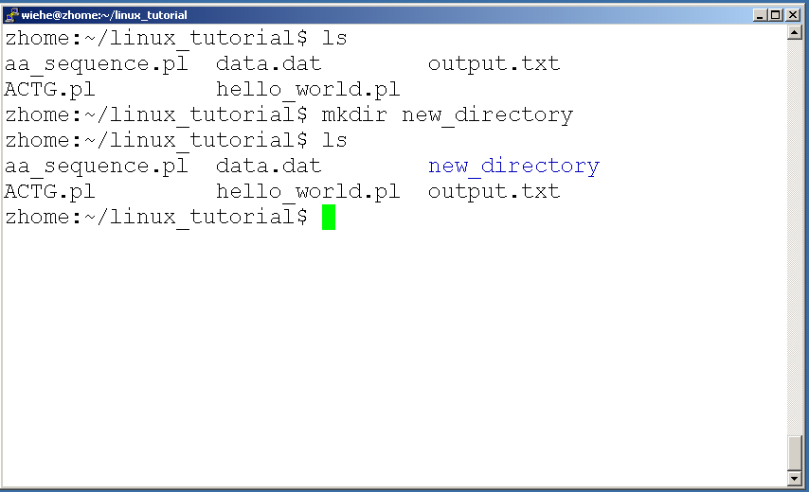
Command: mkdir
To create a new directory use “mkdir”

Slide 22
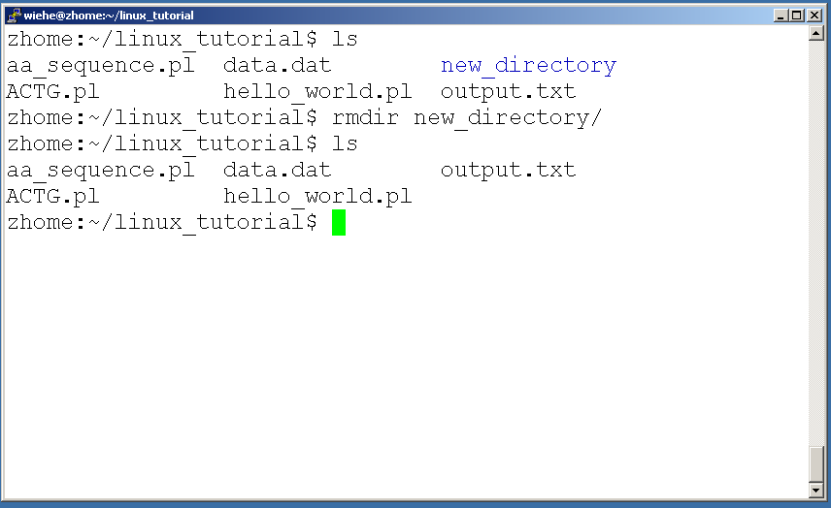
Command: rmdir
To remove and empty directory use “rmdir”

Slide 23
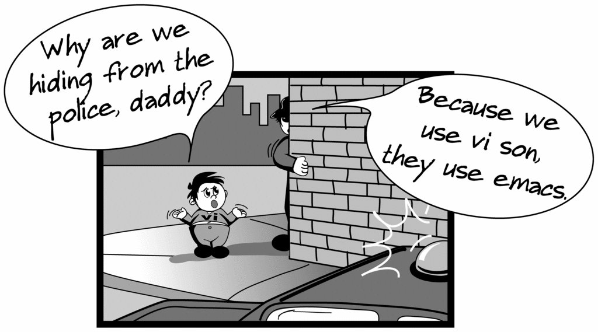
Creating files in Unix/Linux
Requires the use of an Editor
Various Editors:
  nano / pico
  vi
  emacs

Slide 24
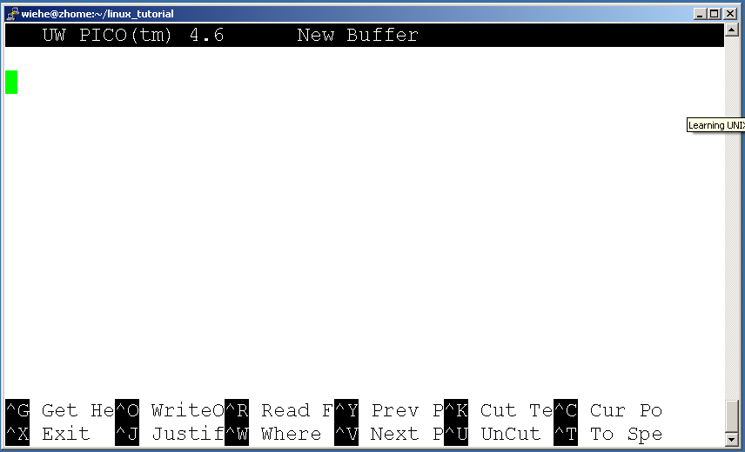
Editing a file using pico or nano
Type “pico” or “nano” at the prompt

Slide 25
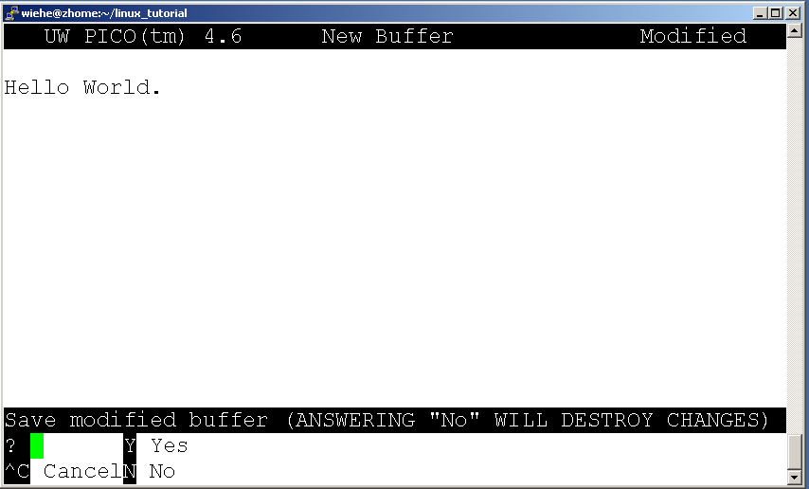
Editing a file using pico
To save use “ctrl-x”

Slide 26
Displaying a file
Various ways to display a file in Unix
  cat
  less
  head
  tail

Slide 27
Command: cat
Dumps an entire file to standard output
Good for displaying short, simple files

Slide 28
Command: less
“less” displays a file, allowing forward/backward movement within it
  return scrolls forward one line, space one page
  y scrolls back one line, b one page
use “/” to search for a string
Press q to quit

Slide 29
Command: head
“head” displays the top part of a file
By default it shows the first 10 lines
-n option allows you to change that
“head -n50 file.txt” displays the first 50 lines of file.txt

Slide 30
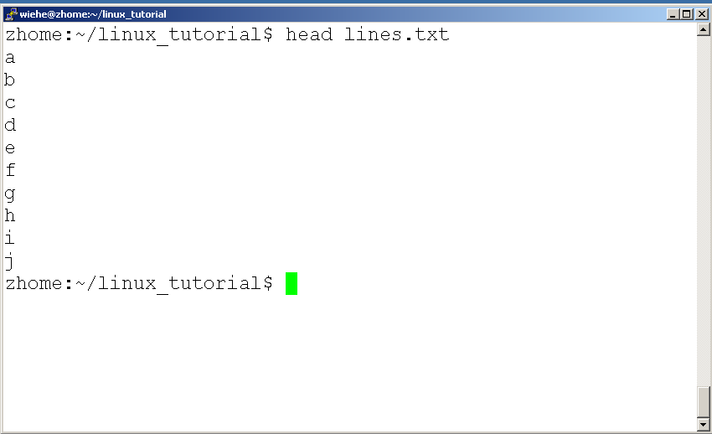
Command: head
Here’s an example of using “head”:

Slide 31
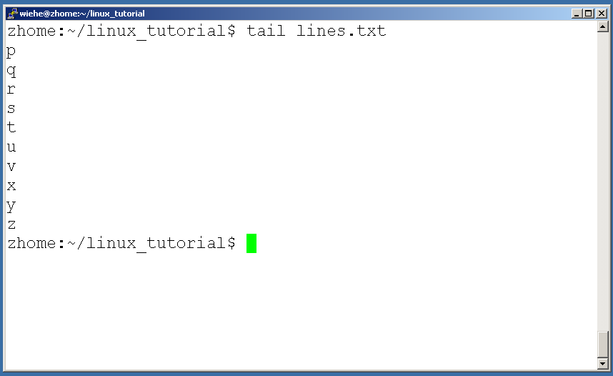
Command: tail
Same as head, but shows the last lines

Slide 32
File Commands
Copying a file: cp
Move or rename a file: mv
Remove a file: rm

Slide 33
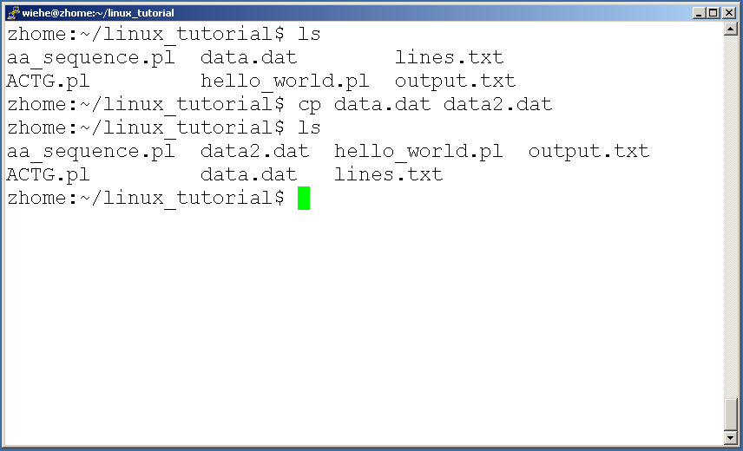
Command: cp
To copy a file use “cp”

Slide 34
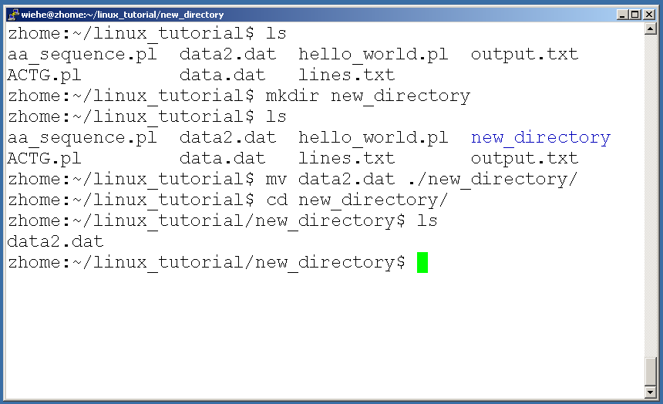
Command: mv
To move a file to a different location use “mv”

Slide 35
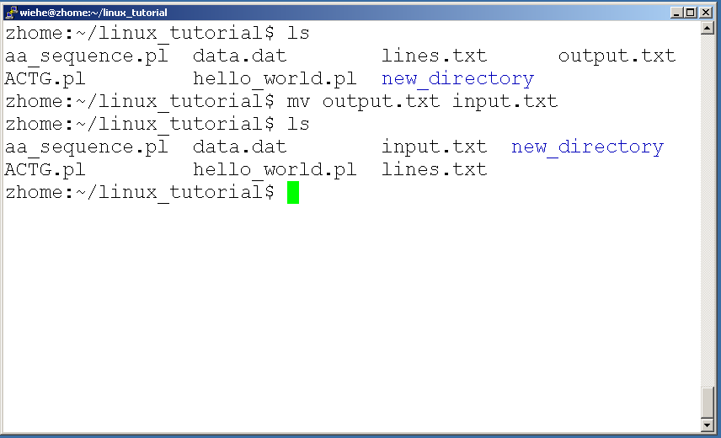
Command: mv
mv can also be used to rename a file

Slide 36
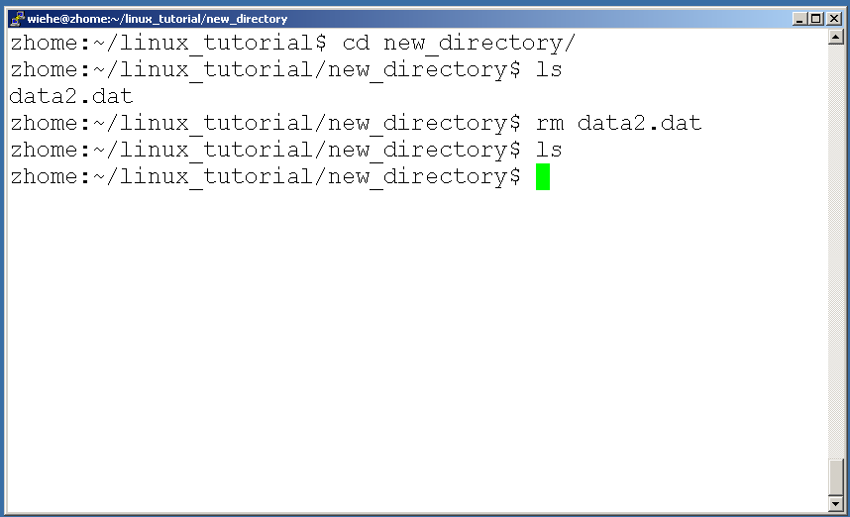
Command: rm
To remove a file use “rm”

Slide 37
Command: rm
To remove a file “recursively”: rm –r
Used to remove all files and directories
Be very careful, deletions are permanent in Unix/Linux

Slide 38
File permissions
Each file in Unix/Linux has an associated permission level
This allows the user to prevent others from reading/writing/executing their files or directories
Use “ls -l filename” to find the permission level of that file

Slide 39
Permission levels
“r” means “read only” permission
“w” means “write” permission
“x” means “execute” permission
  In case of directory, “x” grants permission to list directory contents

Slide 40
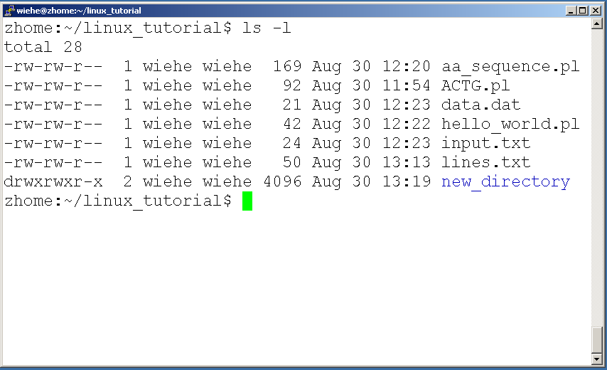
File Permissions
User (you)

Slide 41
File Permissions
Group

Slide 42
File Permissions
“The World”

Slide 43
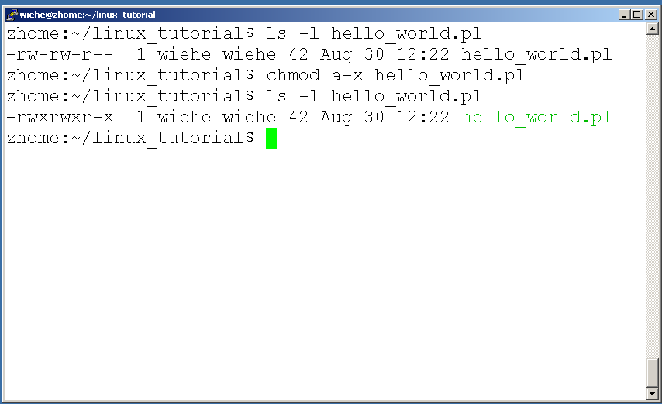
Command: chmod
If you own the file, you can change it’s permissions with “chmod”
  Syntax: chmod [user/group/others/all]+[permission] [file(s)]
  Below we grant execute permission to all:

Slide 44
Running a program (a.k.a. a job)
Make sure the program has executable permissions
Use “./” to run the program

Slide 45
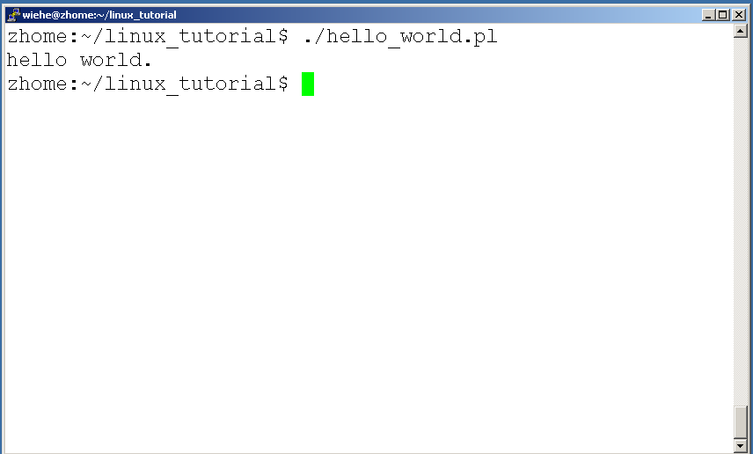
Running a program: an example
Running the sample perl script “hello_world.pl”

Slide 46
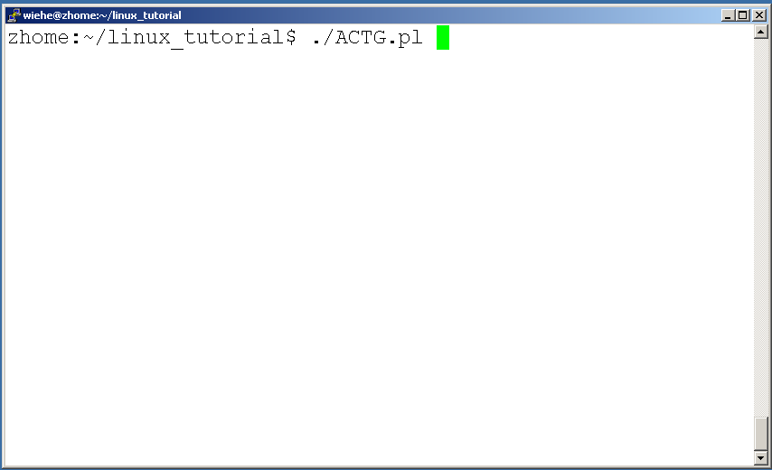
Ending a program
To end a program use “ctrl-c”. To try it:

Slide 47
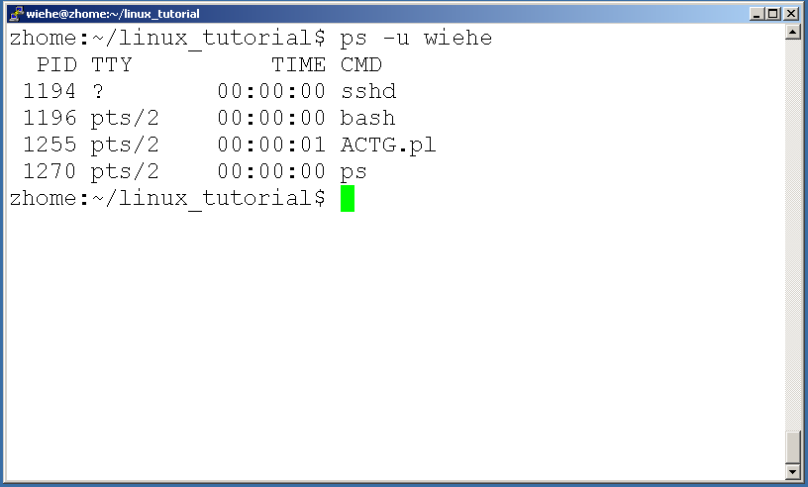
Command: ps
To view the processes that you’re running:

Slide 48
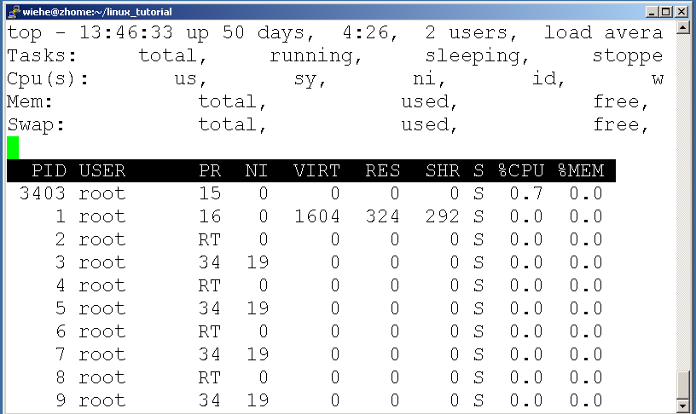
Command: top
To view the CPU usage of all processes:

Slide 49
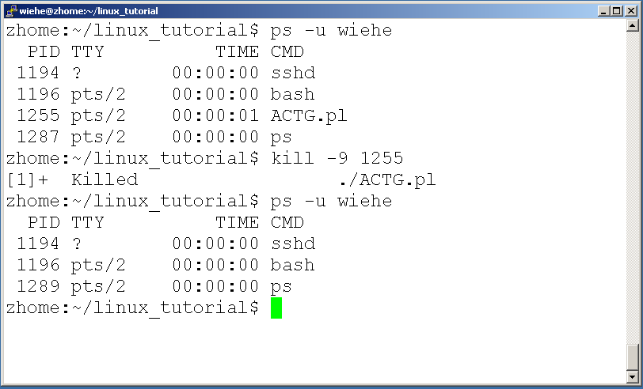
Command: kill
To terminate a process use “kill”

Slide 50
Input/Output Redirection (“piping”)
Programs can output to other programs
Called “piping”
“program_a | program_b”
  program_a’s output becomes program_b’s input
“program_a > file.txt”
  program_a’s output is written to a file called “file.txt”
“program_a < input.txt”
  program_a gets its input from a file called “input.txt”

Slide 51
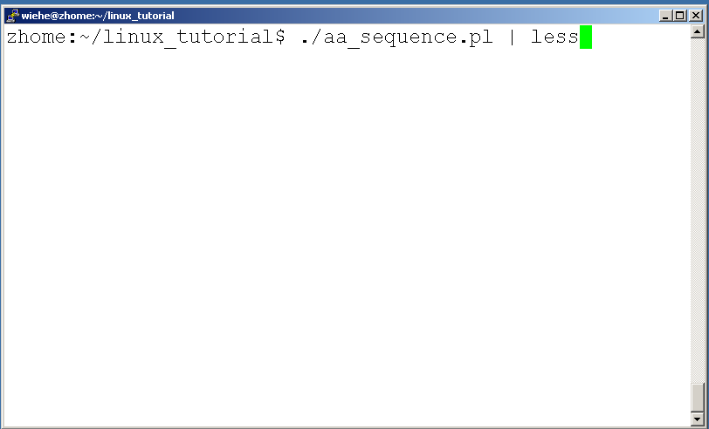
A few examples of piping

Slide 52
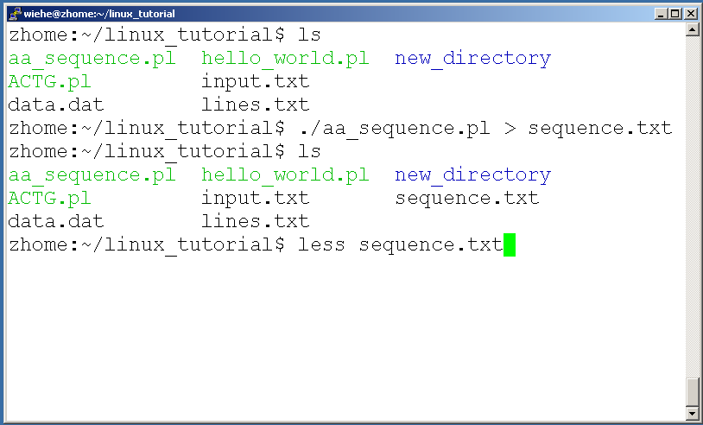
A few examples of piping

Slide 53
Command: wc
To count the characters, words, and lines in a file use “wc”
The first column in the output is lines, the second is words, and the last is characters

Slide 54
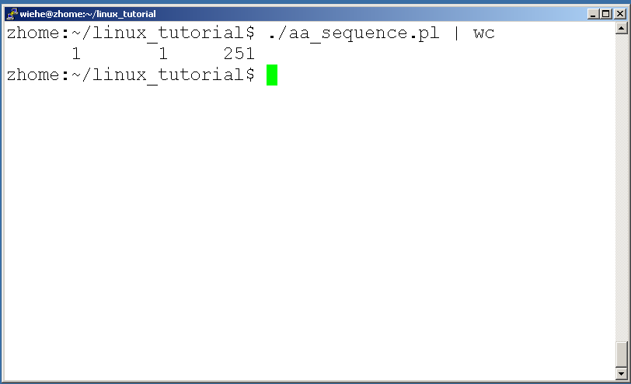
A few examples of piping

Slide 55
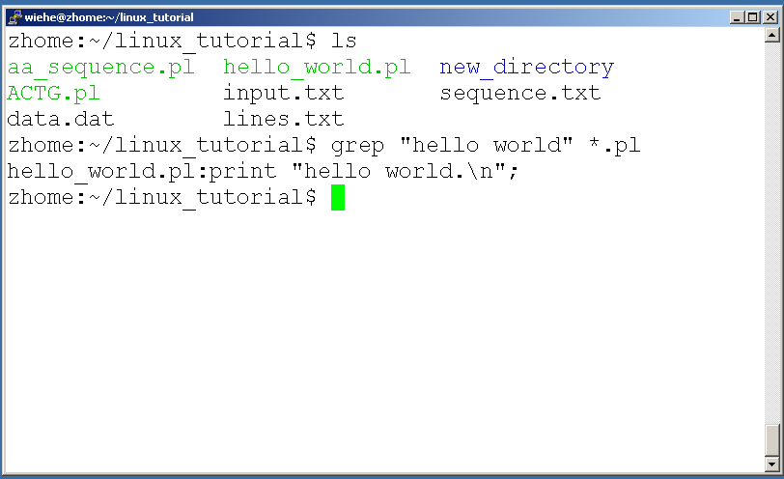
Command: grep
To search files in a directory for a specific string use “grep”

Slide 56
Command: diff
To compare to files for differences use “diff”
  Try: diff /dev/null hello.txt
  /dev/null is a special address -- it is always empty, and anything moved there is deleted

Slide 57
ssh, scp
ssh is used to securely log in to remote systems, successor to telnet
ssh [username]@[hostname]
Try:
ssh yourusername@localhost
  Type “exit” to log out of session
Scp is used to copy files to/from remote systems, syntax is similar to cp:
  scp [local path] [usernme]@[hostname]:[remote file path]
Try:
  scp hello.txt yourusername@localhost:scp-test.txt

Slide 58
Unix Web Resources
http://www.ee.surrey.ac.uk/Teaching/Unix/
http://www.ugu.com/sui/ugu/show?help.beginners
http://en.wikipedia.org/wiki/Unix

